Slide 1

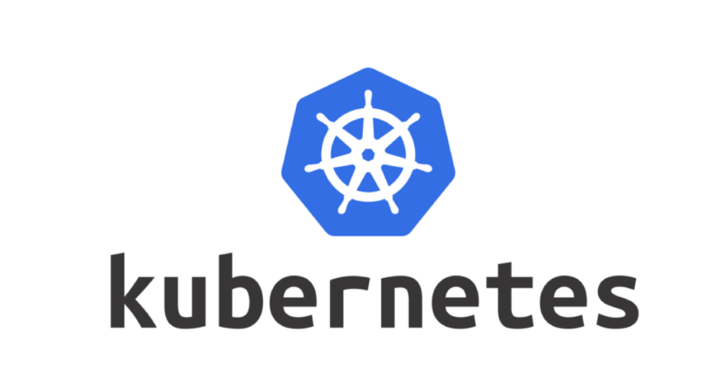

Slide 2
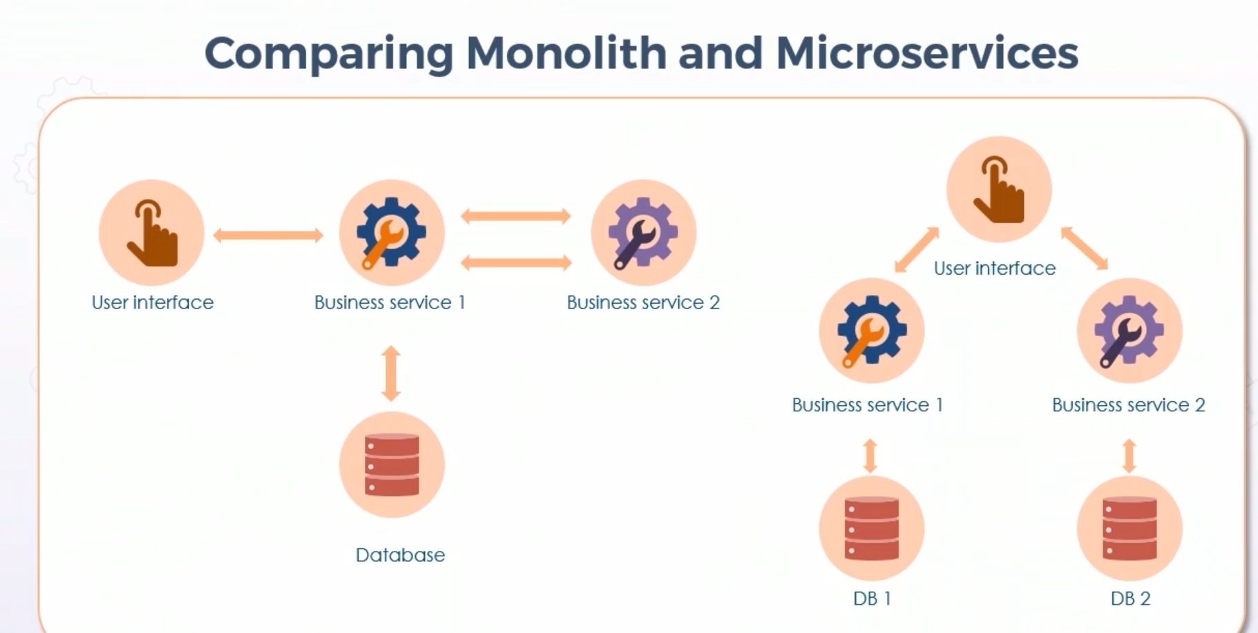
Evolution of Applications
Monolith
Microservices
Monolith :
Complete application is packaged as a unit and deployed on to the server
MicroServices :
Application is broken down into multiple individually executable services. With each service offering some functionality
Monolith vs MicroServices :

Slide 3
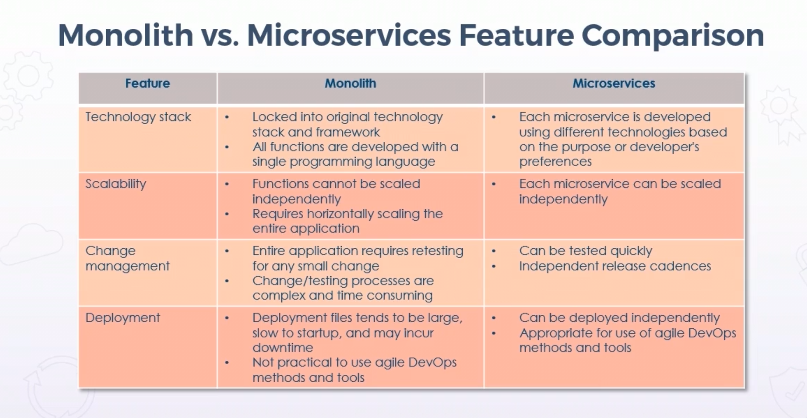

Slide 4
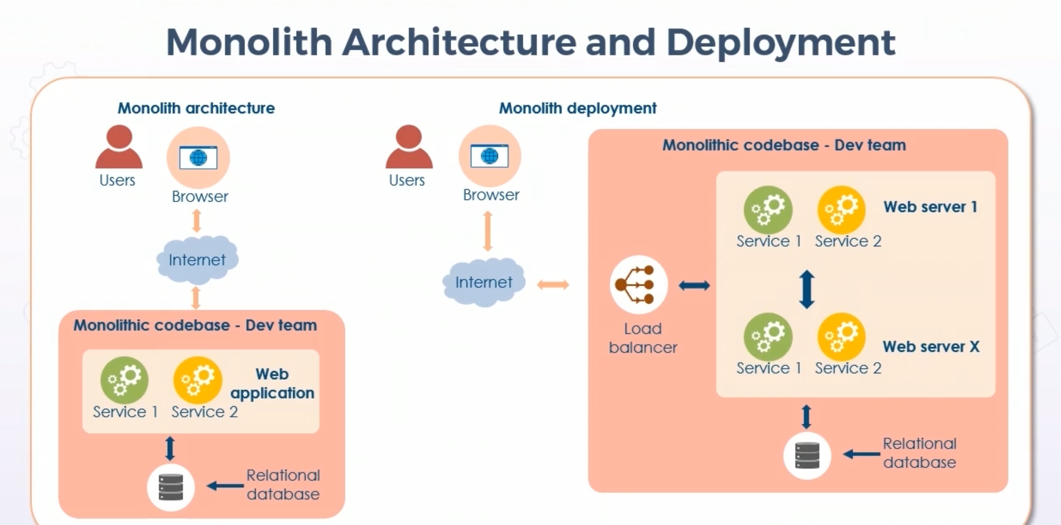
When we want to deploy any application then we need to identify how many web servers that we are going to use
Entries for those web servers need to be present in a load balancer configuration file, According to that load balancer will route the traffic to the services which are healthy

Slide 5
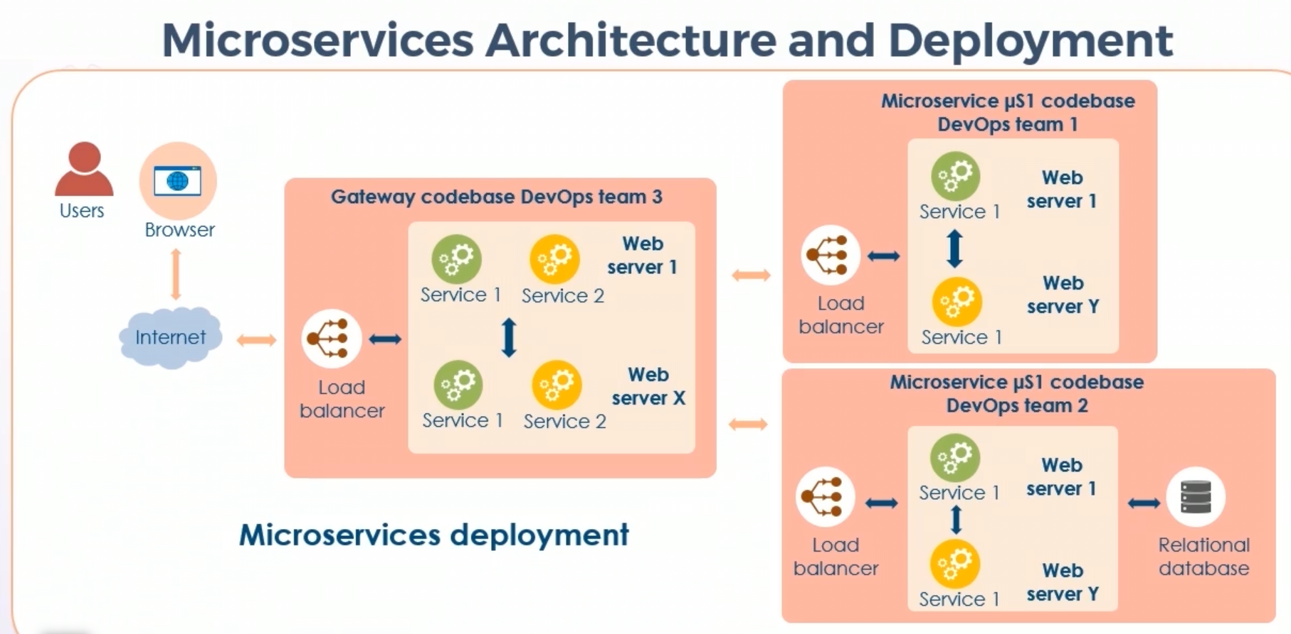
Each service is independently deployed in micro service environment.
If one service is busy serving others then it will create another service instance to serve other request.
we can have load balancer per service and it can scaled horizontally.

Slide 6
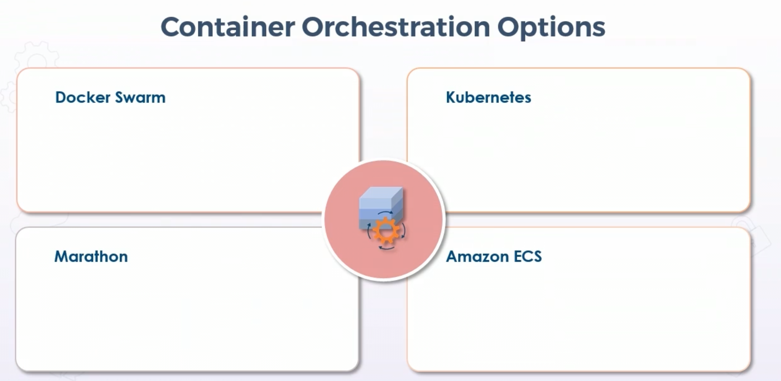

Slide 7
Kubernetes (k8s)
k8s is a platform that is used with huge number of services & capabilities that keeps growing.
The core functionality of k8s is schedule workloads in containers across your infra.
In addition to this there are many functionalities that k8s brings in
Managing storage systems
Secret Management
Application health & readiness check
Replicating application instances
Horizontal pod Autoscaling
Cluster Autoscaling
Naming & Service Discovery
Balancing loads
Rolling updates
Resource Monitoring
Log Management
Application debugging
Authentication & Authorization

Slide 8
k8s components Cluster: It is collection of hosts(nodes) that provide compute, memory, storage and networking resources k8s uses these resources to run application workloads. Master Node: The master node is a single host in k8s cluster. This can be a physical server or virtual machine This is the control plane of k8s. This master is responsible for assigning work (container workloads) to be scheduled on nodes Worker Nodes: It is a single host in k8s cluster This can be physical server or virtual machine These are managed by k8s master and they do the work of executing workloads in k8s Node is responsible for doing the work assigned.

Slide 9
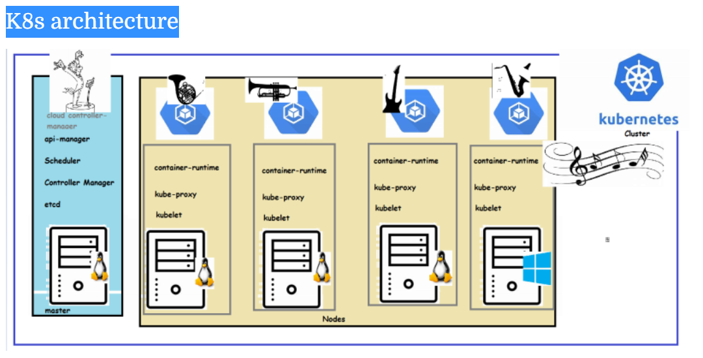

Slide 10
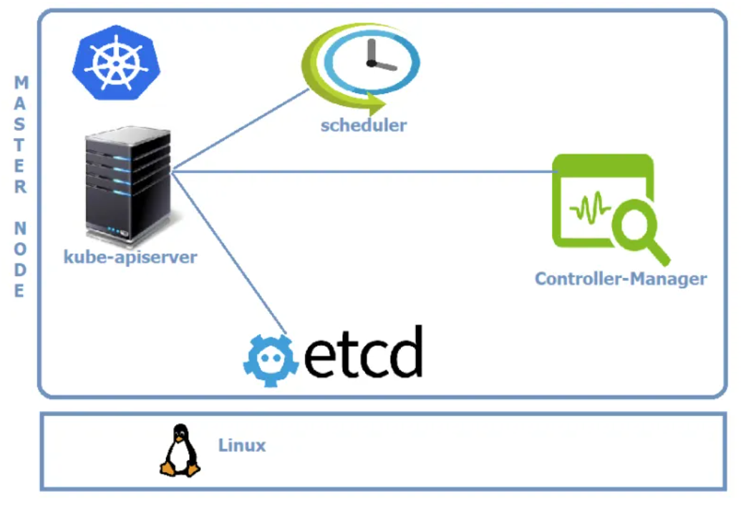
Kubernetes Master
Master Components
Kube-apiserver
This component is Central to Kubernetes. All communications between all components goes through the kube-apiserver
We would interact with this component using kubectl by using the YAML files, which are also referred as manifests

Slide 11
Etcd
Etcd stores the entire configuration and the state of the cluster.
Etcd is consistent and highly available distributed key-value store.
Kube-scheduler
It watches for new work tasks and assigns them to healthy nodes in the cluster
Controller-Manager
It is responsible for maintaining desired states mentioned in the manifest.
It looks like single component, but with in it has
Node Controller: for noticing & responding when node goes down
Replication Controller: for maintaining the correct number of pods for every replication controller object.
Endpoints Controller: Populates the Endpoints object
Cloud-Controller-manager
If you run the Kubernetes on a supported cloud platform such as AWS, Azure or Google, your control plane runs the Cloud-Controller-Manager.
It is responsible for underlying cloud specific controllers.

Slide 12
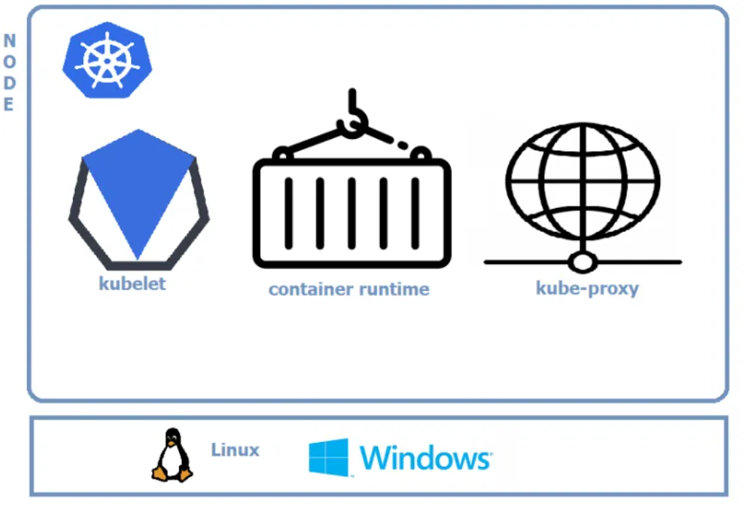
Node Components
kubelet
This is an agent which runs on each node in the cluster.
It watches for the instructions from API Server for new work assignments.
If it can’t run the task assigned, it reports back to master and lets control plane decide on the actions.
It is responsible for the node registration process
Container Runtime
This is software which is responsible for running containers.
Some of them are Docker, containerd, cri-o, rktlet
Kube-proxy
Maintains the network rules on nodes
This is responsible for networking on nodes.

Slide 13
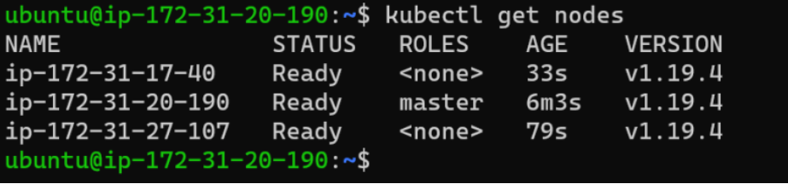
K8s Installations
K8s has many ways of installations.
Installing k8s with deployment tools Refer Here :https://kubernetes.io/docs/setup/production-environment/tools/kubeadm/install-kubeadm/
kubernetes for local laptop/single workstation Refer Here : https://kubernetes.io/docs/tasks/tools/
Kubeadm installation
Refer Here : https://kubernetes.io/docs/setup/production-environment/tools/kubeadm/install-kubeadm/
for official documentation
Install Docker and kubeadmin,kubectl on all the three servers as mentioned in above documentation.
Now login into master and execute kubeadm init command
After Applying pod network join two nodes to cluster by executing kubeadm join command
After joining nodes, login into master and execute kubectl get nodes
Example :

Slide 14
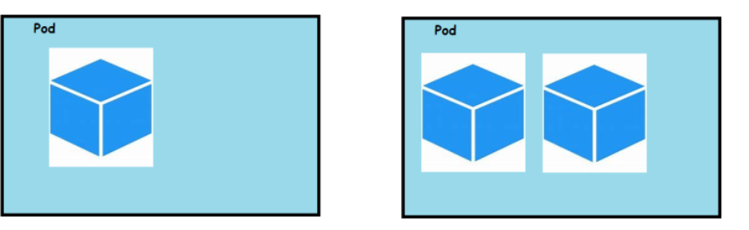
kubectl
This is a command-line utility which we would be using to interact with k8s cluster.
This utility creates api-request internally and forwards them to kube-api server
kubectl cheat sheet : https://kubernetes.io/docs/reference/kubectl/cheatsheet/
Kubernetes Objects
k8s objects are persistent entities in the k8s system.
These objects are used to represent the state of your cluster
Every k8s object has
Specification: This is also referred as object Spec
Status: This is also referred as object status
How can we describe a k8s object (Specification):
K8s objects can be describe in the json format using k8s rest api or in yaml format via kubectl
For api version https://kubernetes.io/docs/reference/generated/kubernetes-api/v1.19/
K8s Pods
Pods are the atomic unit of computing that you create in k8s
A pod represents an application/microservice running in k8s cluster.
Pods will have containers in it.

Slide 15
In k8s to create any object we have two ways :
Imperative:
We can create objects by executing commands
Refer here : https://kubernetes.io/docs/tasks/manage-kubernetes-objects/imperative-command/
Declarative:
We create an object specification in a yaml file.
Send/apply this yaml which has a specification & k8s master will do the rest to create/maintain the specification sent
To create this specification we will be using k8s api reference
Every k8s object can be describe using .yaml (specification) or json when using with rest api and passed across to kube-api server via kubectl . The cluster responds back with status
While describing object spec, we will have some required fields :
Api Version: Which version of k8s api are you using to create this object
Kind: what kind of k8s object do you want to create
Metadata: Data which is helpful in uniquely identifying the object
Spec: What is your desired state

Slide 16
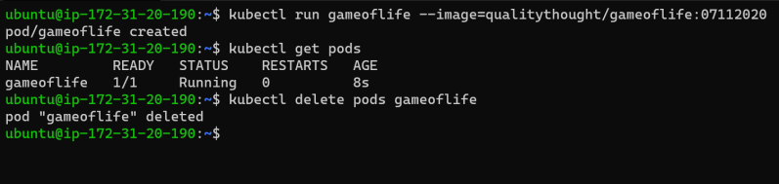
K8s Workloads
Workload is an application running on k8s cluster.
A Pod has a defined lifecycle. If the pod fails, we need to create the new pod running the same application.K8s has workload resources which can maintain desired state of pods
Workload resources are
Deployments : A Deployment provides declarative updates for Pods and ReplicaSets
Replica Sets : A ReplicaSet's purpose is to maintain a stable set of replica Pods
Stateful Sets : Stateful sets are used to Stateful replicas
Daemon Sets : Daemonsets are used to manage creation of a Particular Pod on all or selected nodes in k8s cluster
The Pod Manifest
Pods are described in a Pod Manifest which is a text-file representation of k8s API Object.
Creating a Pod in a imperative kubectl run command

Slide 17
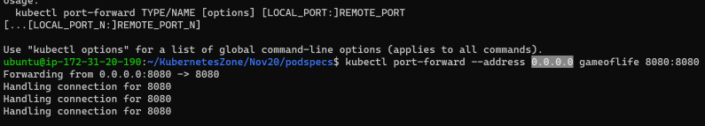
Creating a Pod using a manifest file
apiVersion: v1
kind: Pod
metadata:
name: gameoflife
spec:
containers:
- image: qualitythought/gameoflife:07112020
name: gol
ports:
- containerPort: 8080
name: golhttpport
protocol: TCP
Accessing your pod:

Slide 18
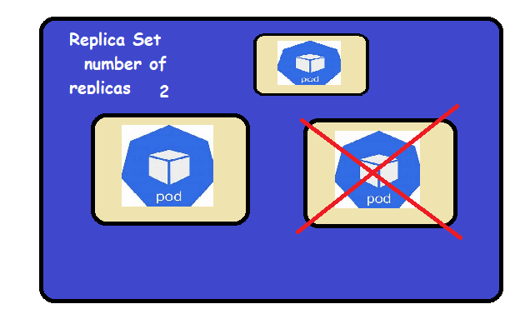
Replica Set
Replica Set will ensure that the number of replicas specified in the spec is maintained by k8s cluster.
K8s will try to maintain the desired state which is number of replicas. If some pod gets deleted/crashed etc, k8s will create one more pod to maintain the desired state.
Pods might be allocated on different cluster nodes
K8S Deployments
Deployment is a k8s object that acts as a wrapper around ReplicaSet and makes it easier to use.
The major reason for Deployment is
it maintains the history of revisions (i.e. history of your application Deployments)
it makes it easy to roll back to previous revisions
it gives a way to do zero down time deployments

Slide 19
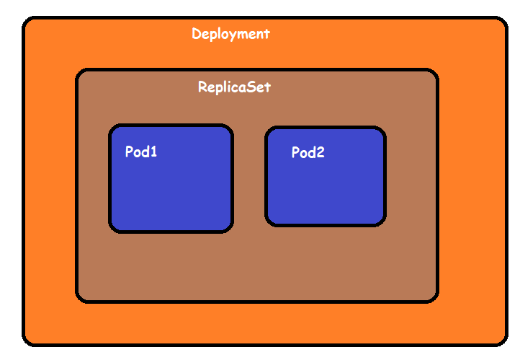
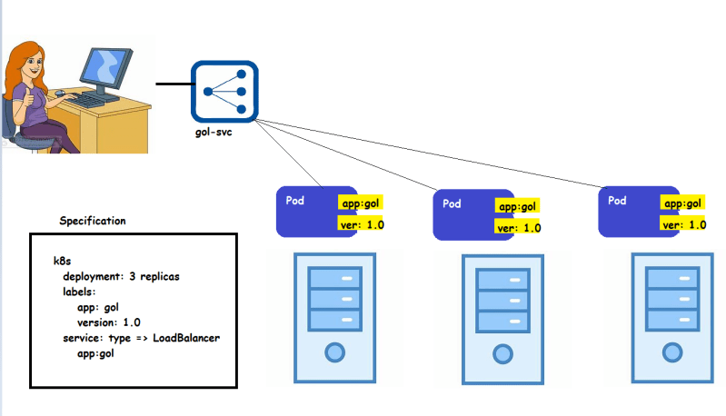
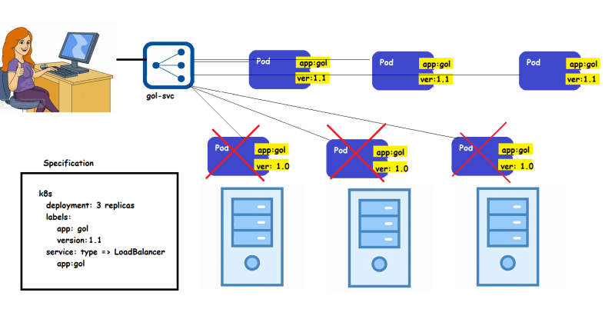
Deployment Strategy:
Rolling Update:
This give an option to deploy your application without having downtime
Recreate:
This option kills all the running pods and recreates new pods

Slide 20


